Slide 1
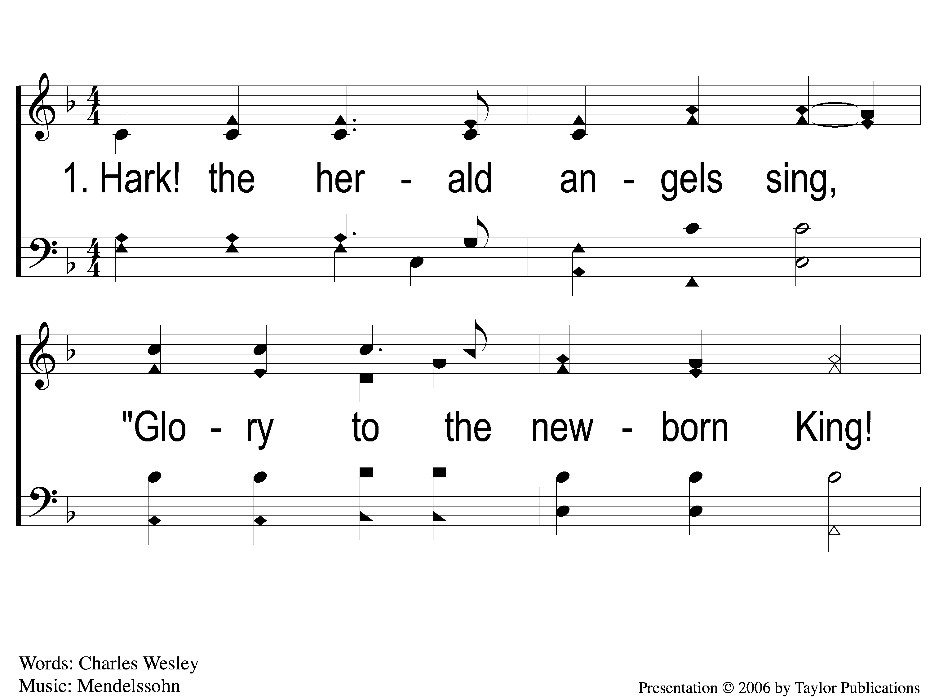
1-1 Hark the Herald Angels Sing
Hark! The Herald Angels Sing
152

Slide 2
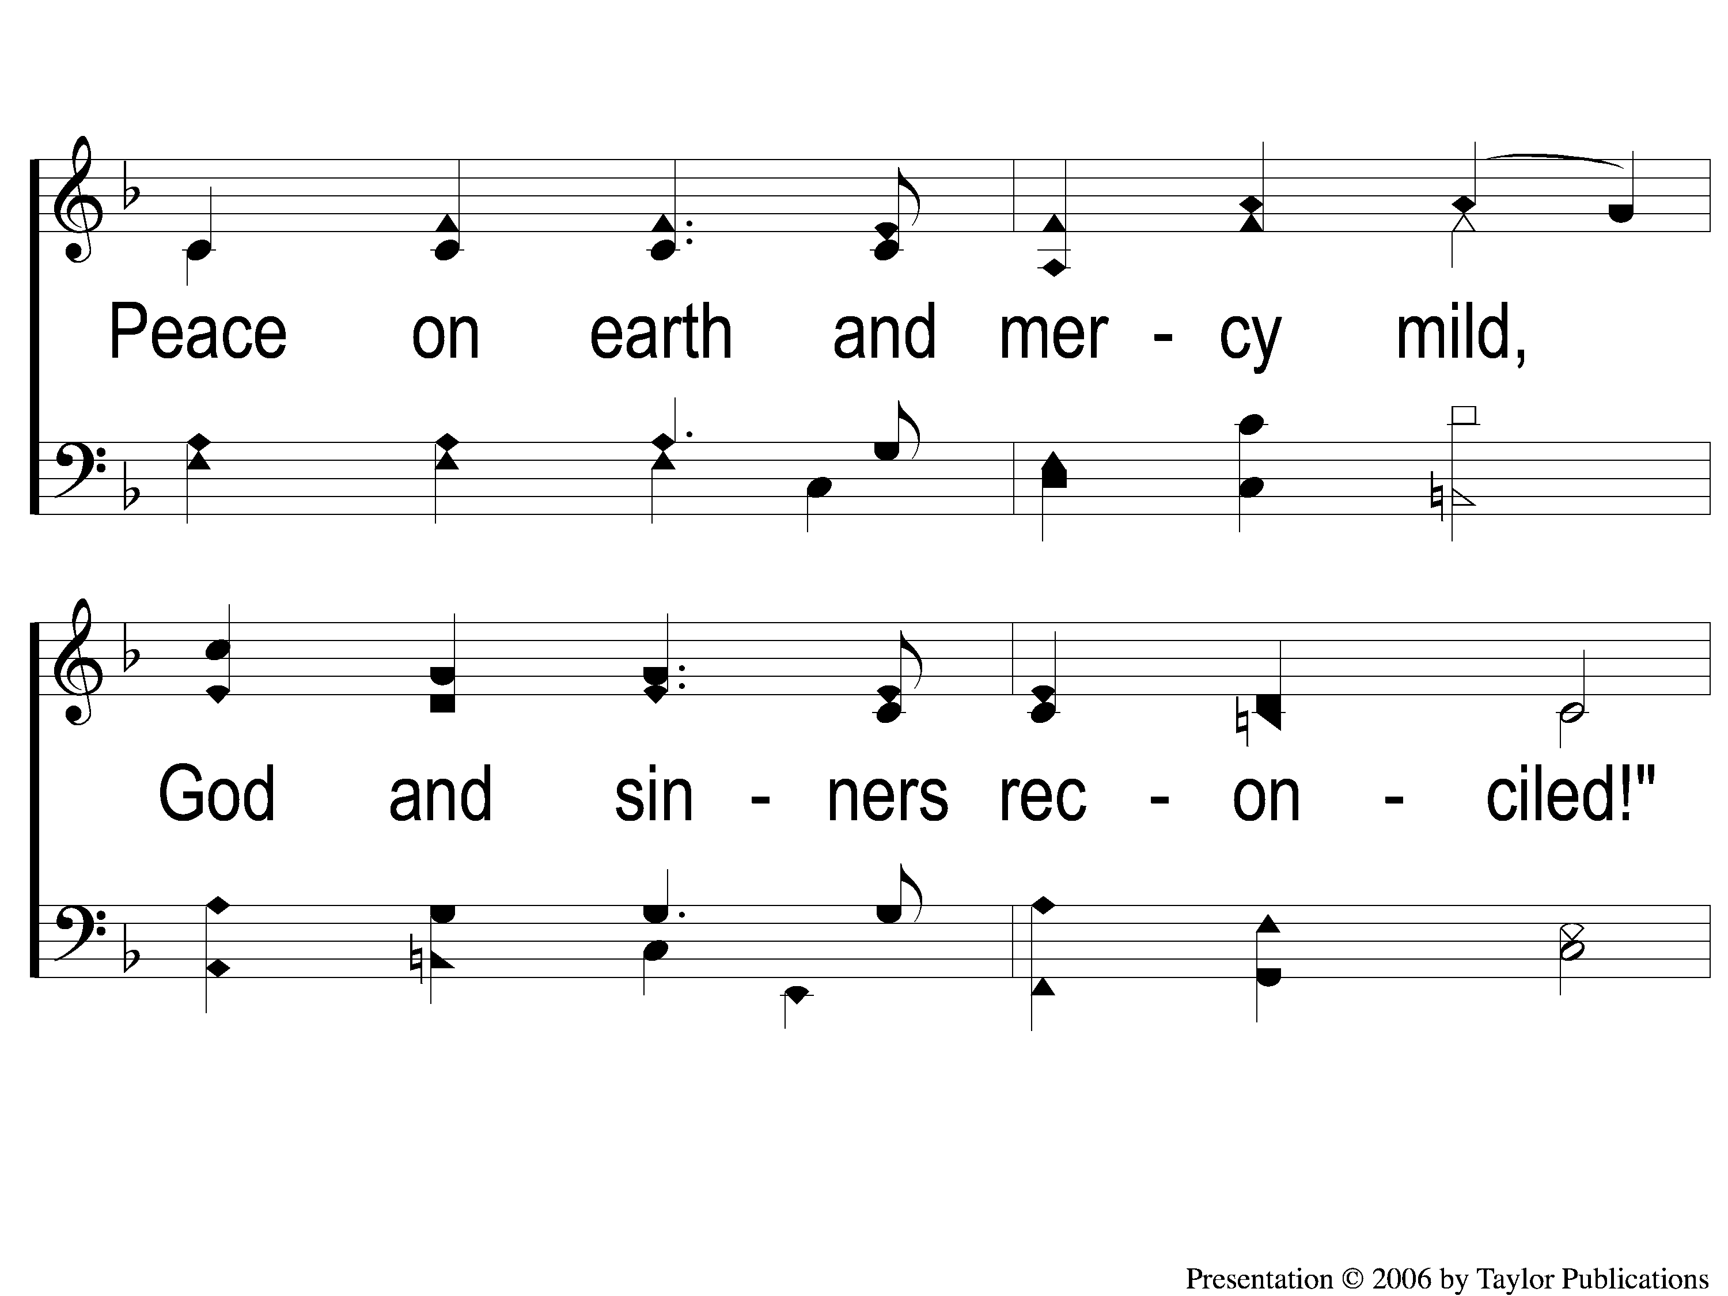
1-2 Hark the Herald Angels Sing
Hark! The Herald Angels Sing
152

Slide 3
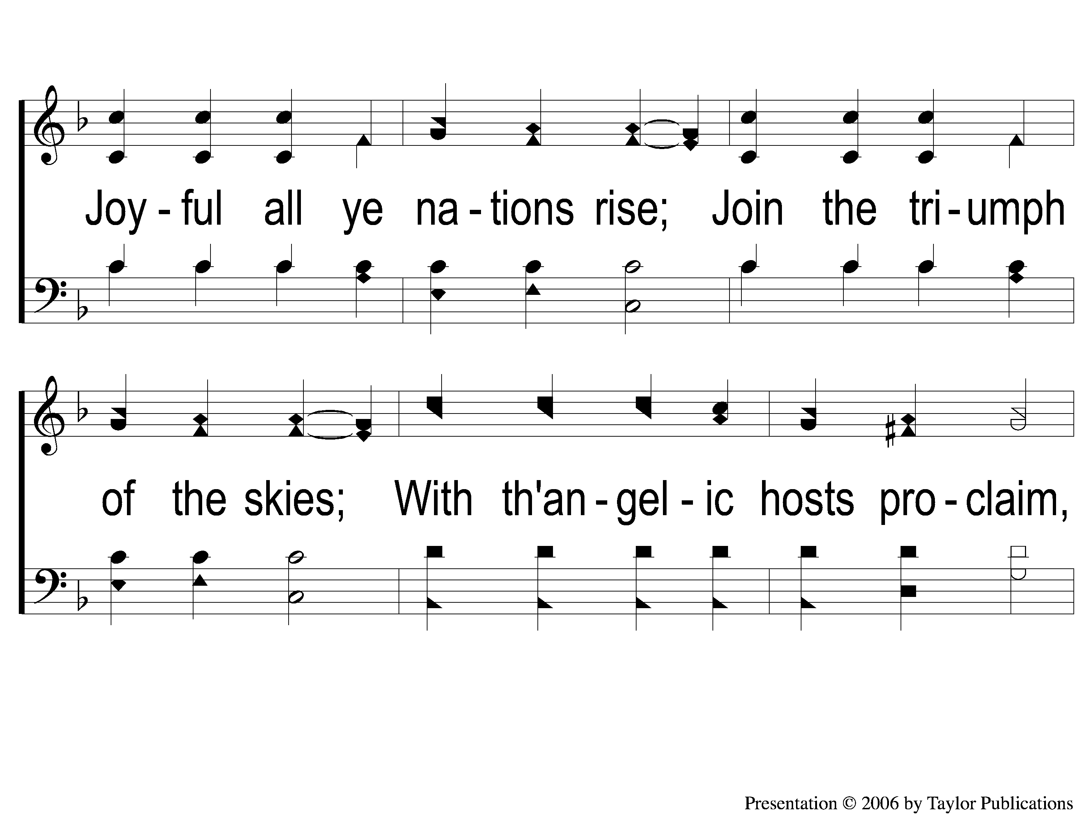
1-3 Hark the Herald Angels Sing
Hark! The Herald Angels Sing
152

Slide 4
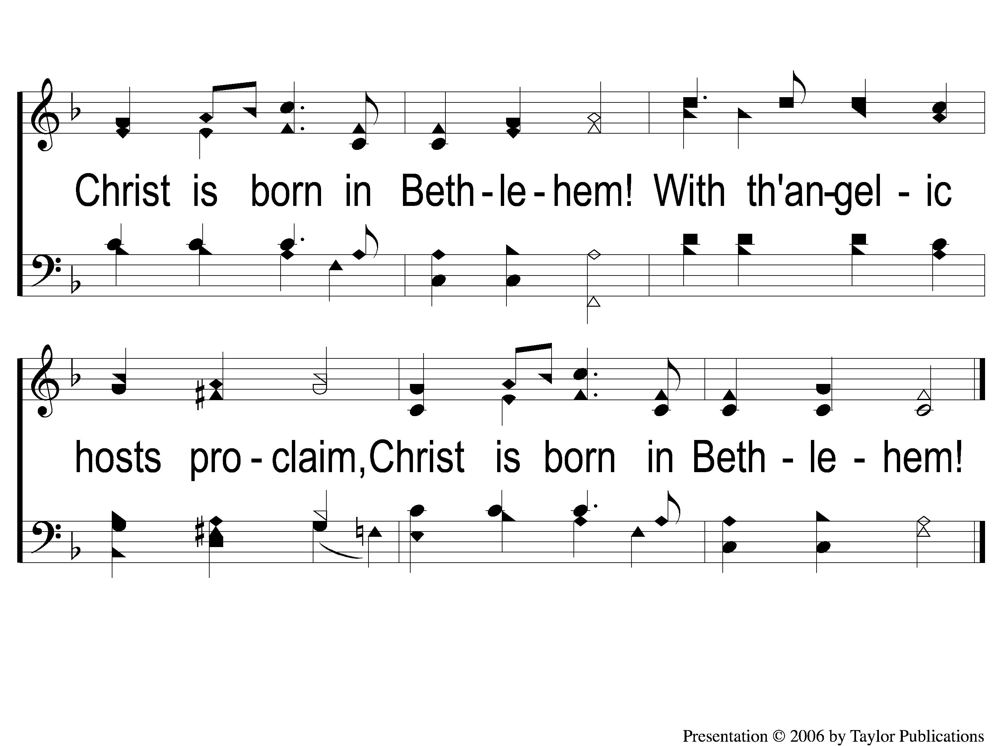
1-4 Hark the Herald Angels Sing
Hark! The Herald Angels Sing
152

Slide 5
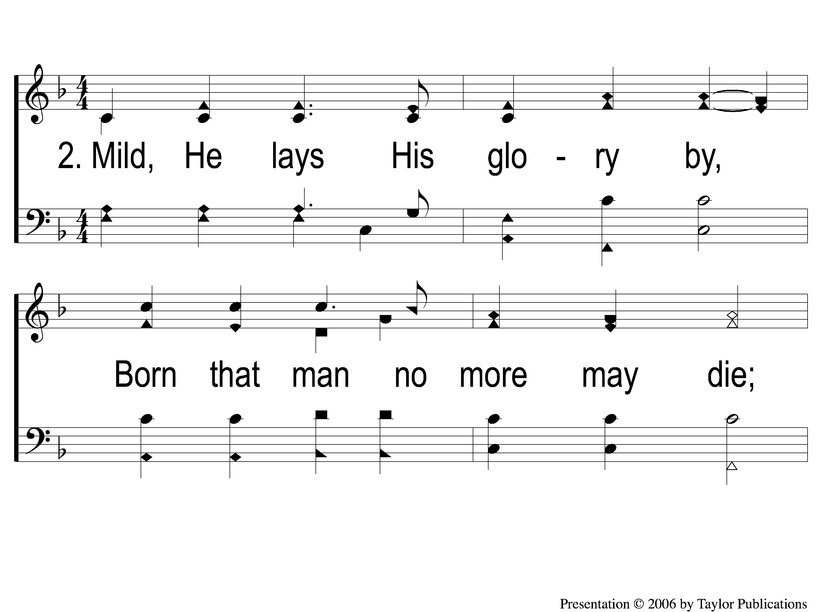
2-1 Hark the Herald Angels Sing
Hark! The Herald Angels Sing
152

Slide 6
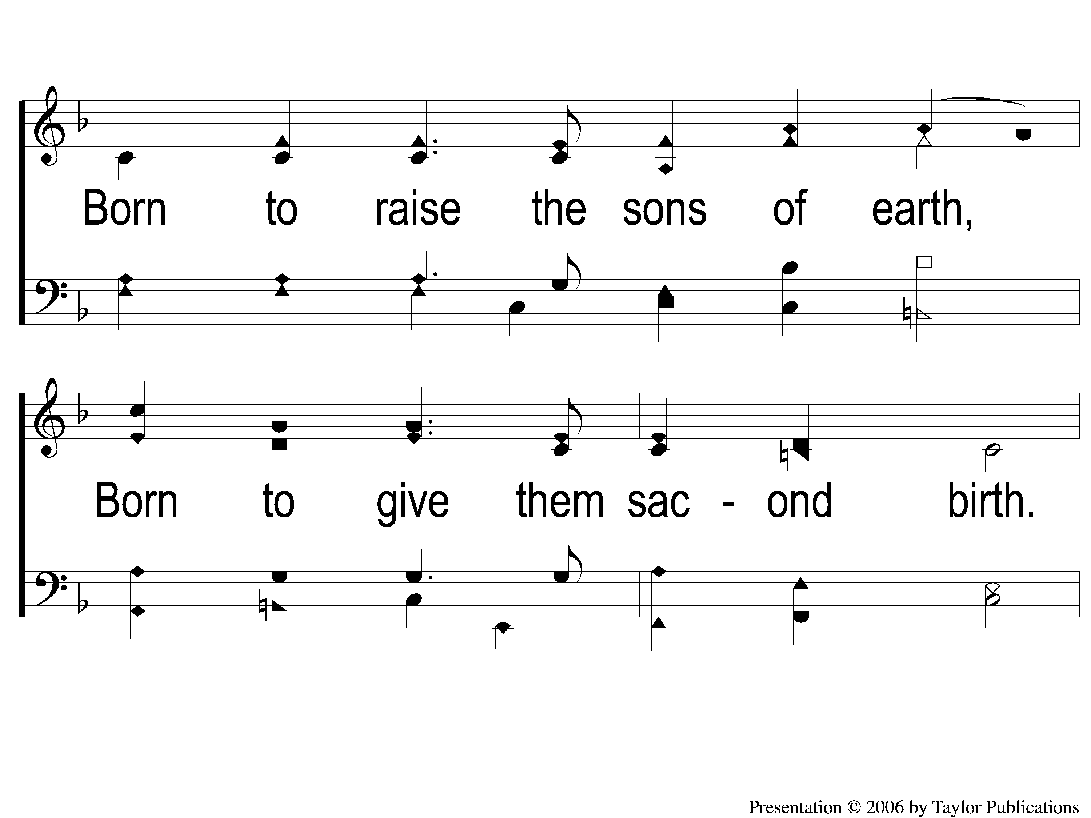
2-2 Hark the Herald Angels Sing
Hark! The Herald Angels Sing
152

Slide 7
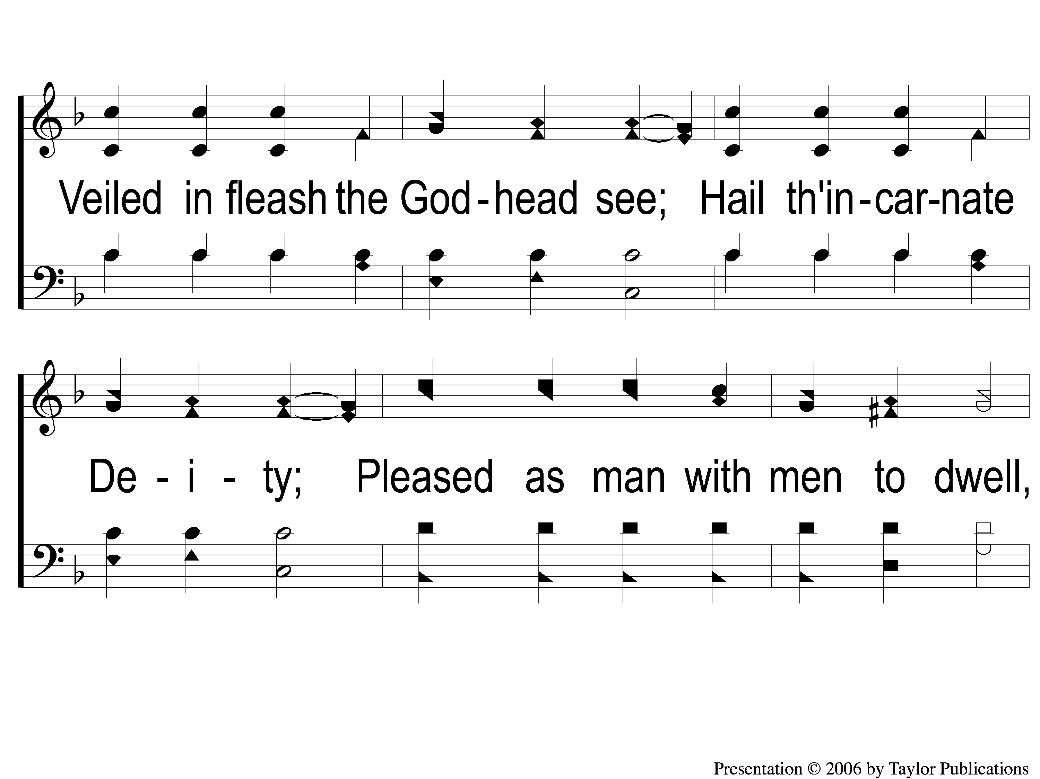
2-3 Hark the Herald Angels Sing
Hark! The Herald Angels Sing
152

Slide 8
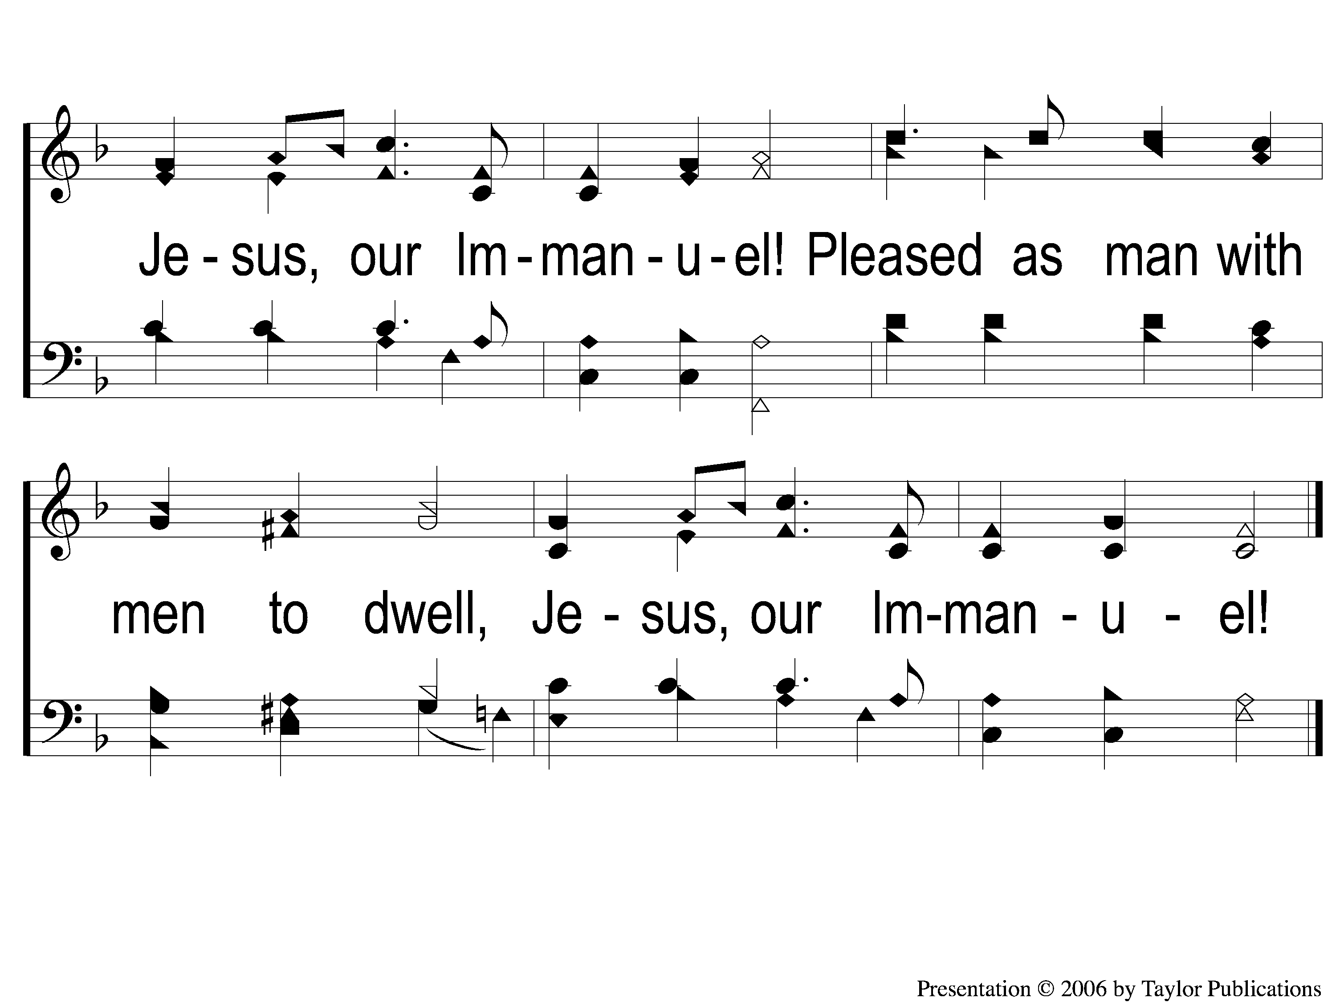
2-4 Hark the Herald Angels Sing
Hark! The Herald Angels Sing
152

Slide 9
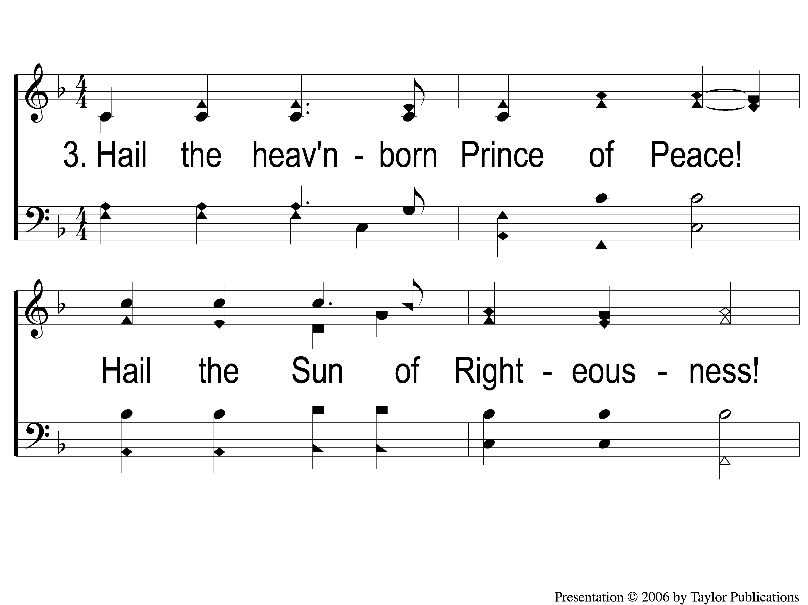
3-1 Hark the Herald Angels Sing
Hark! The Herald Angels Sing
152

Slide 10
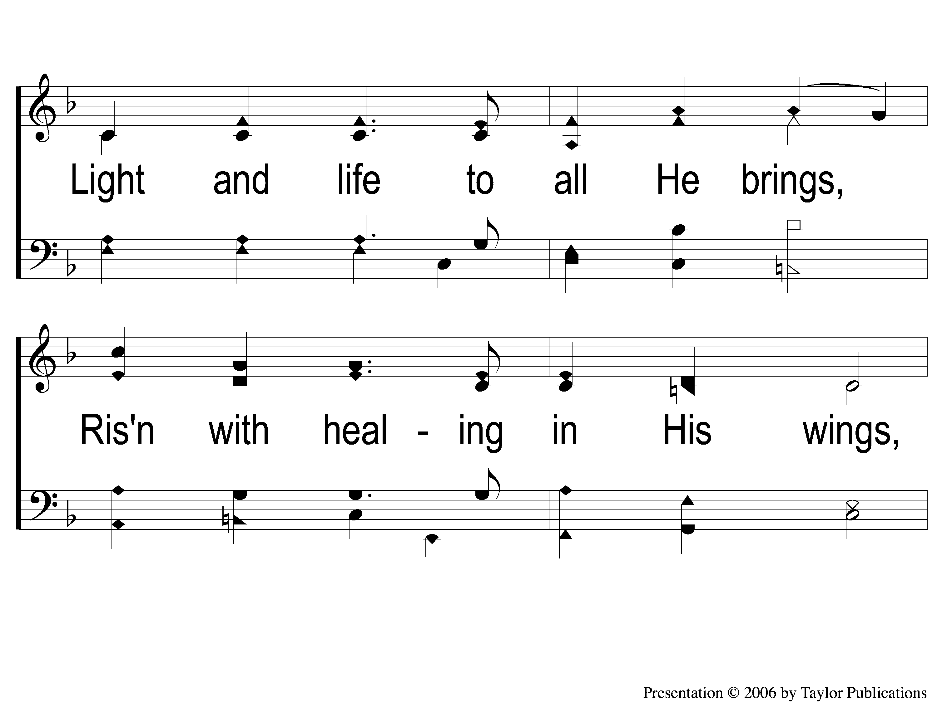
3-2 Hark the Herald Angels Sing
Hark! The Herald Angels Sing
152

Slide 11
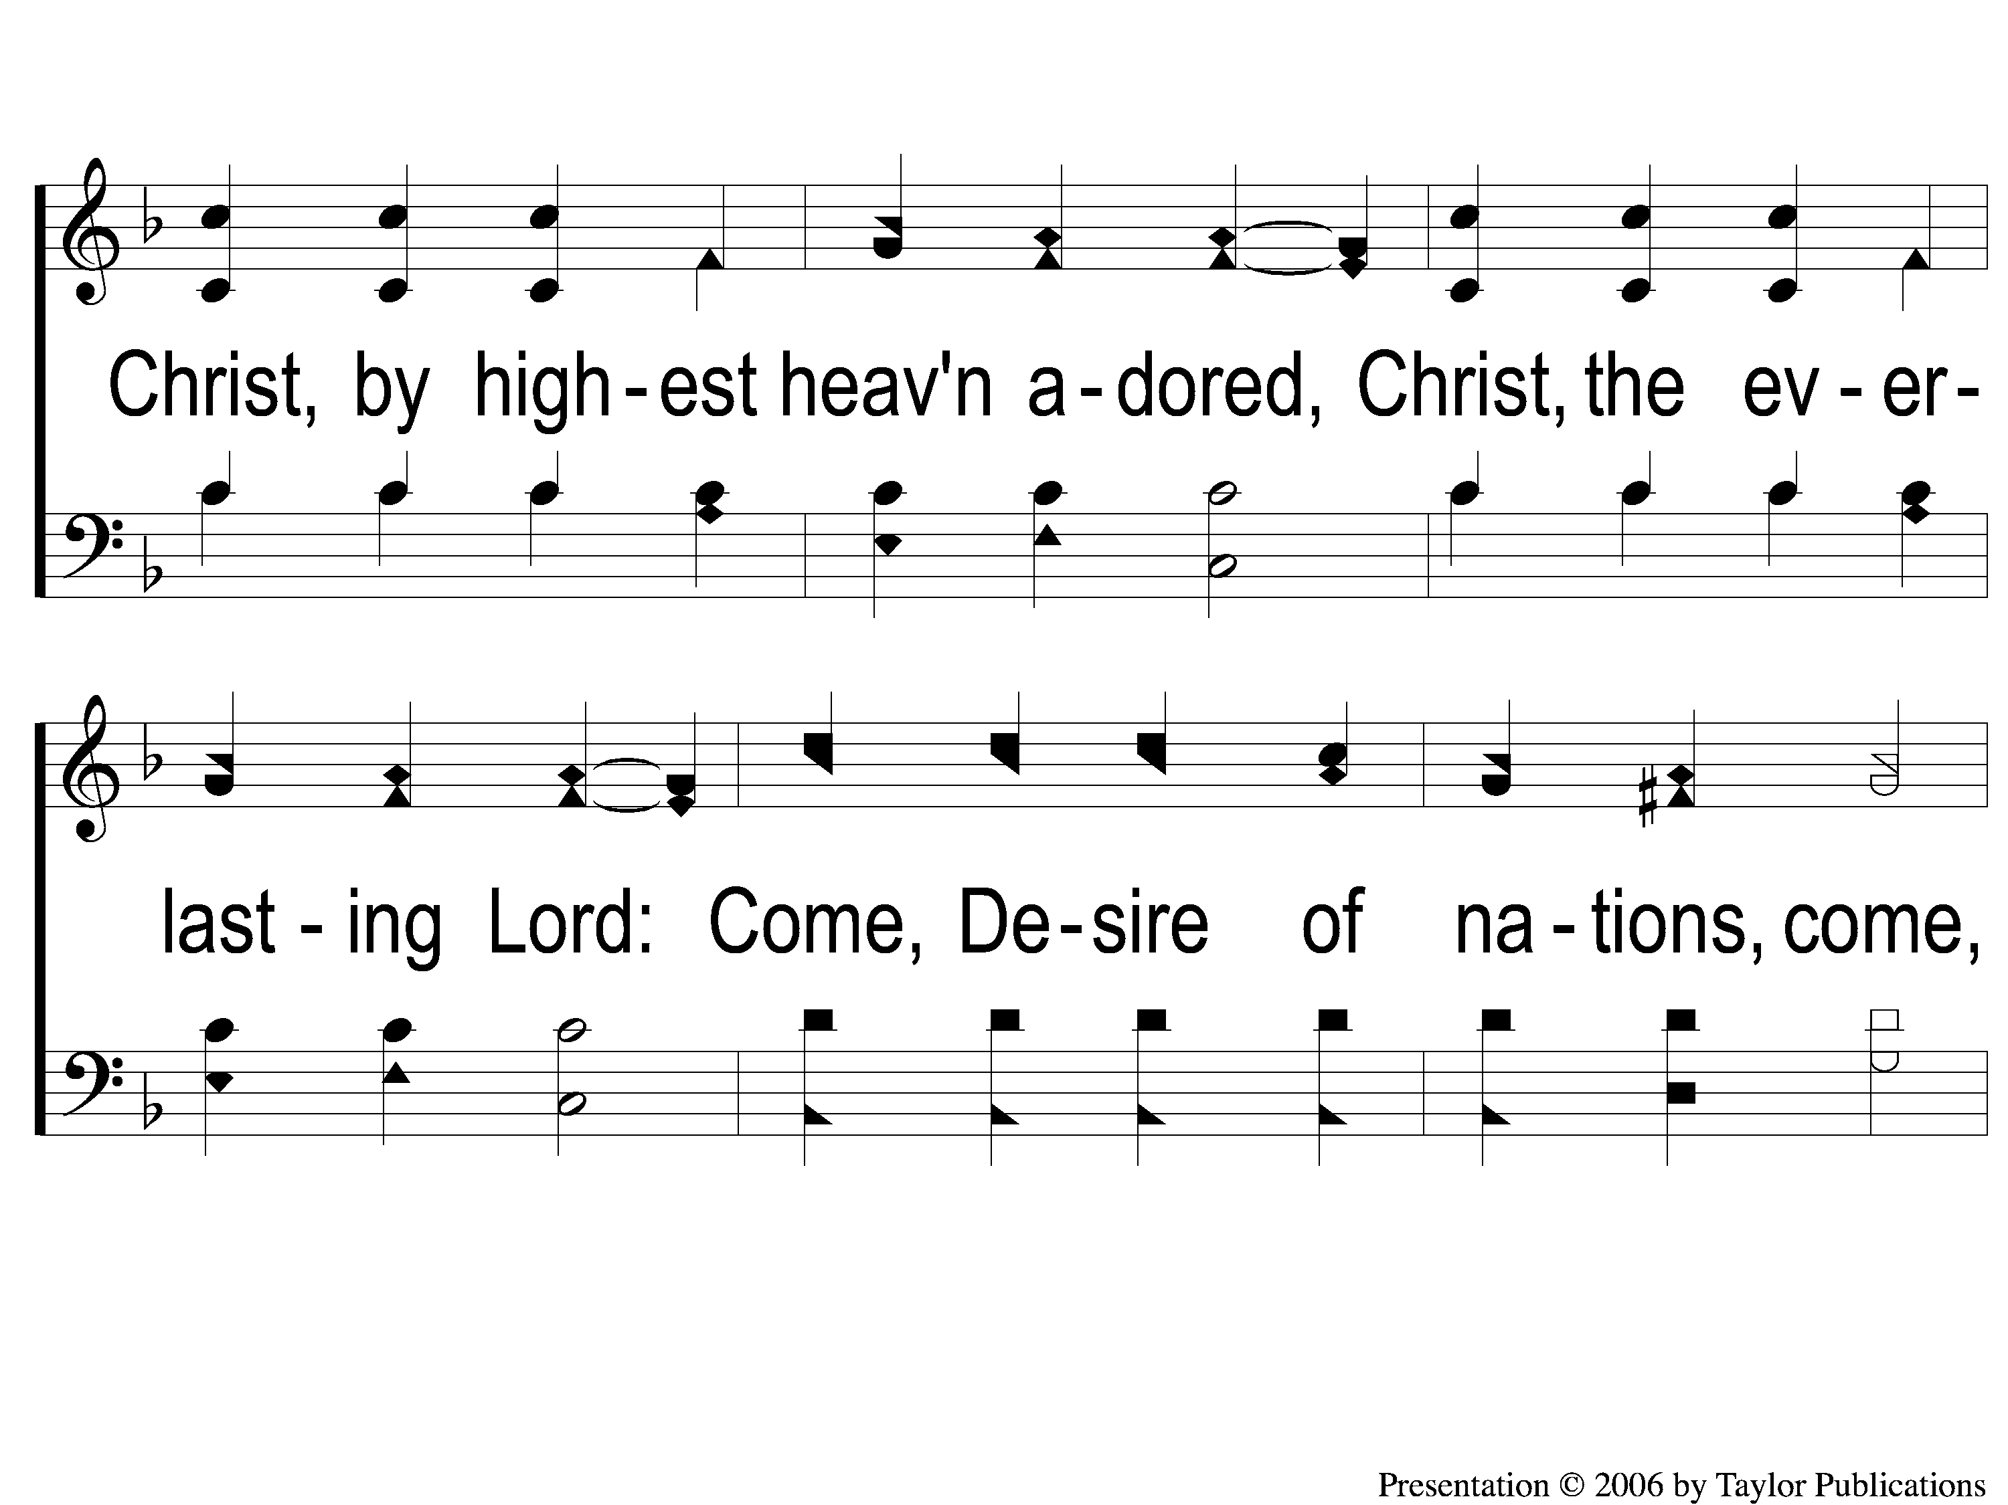
3-3 Hark the Herald Angels Sing
Hark! The Herald Angels Sing
152

Slide 12
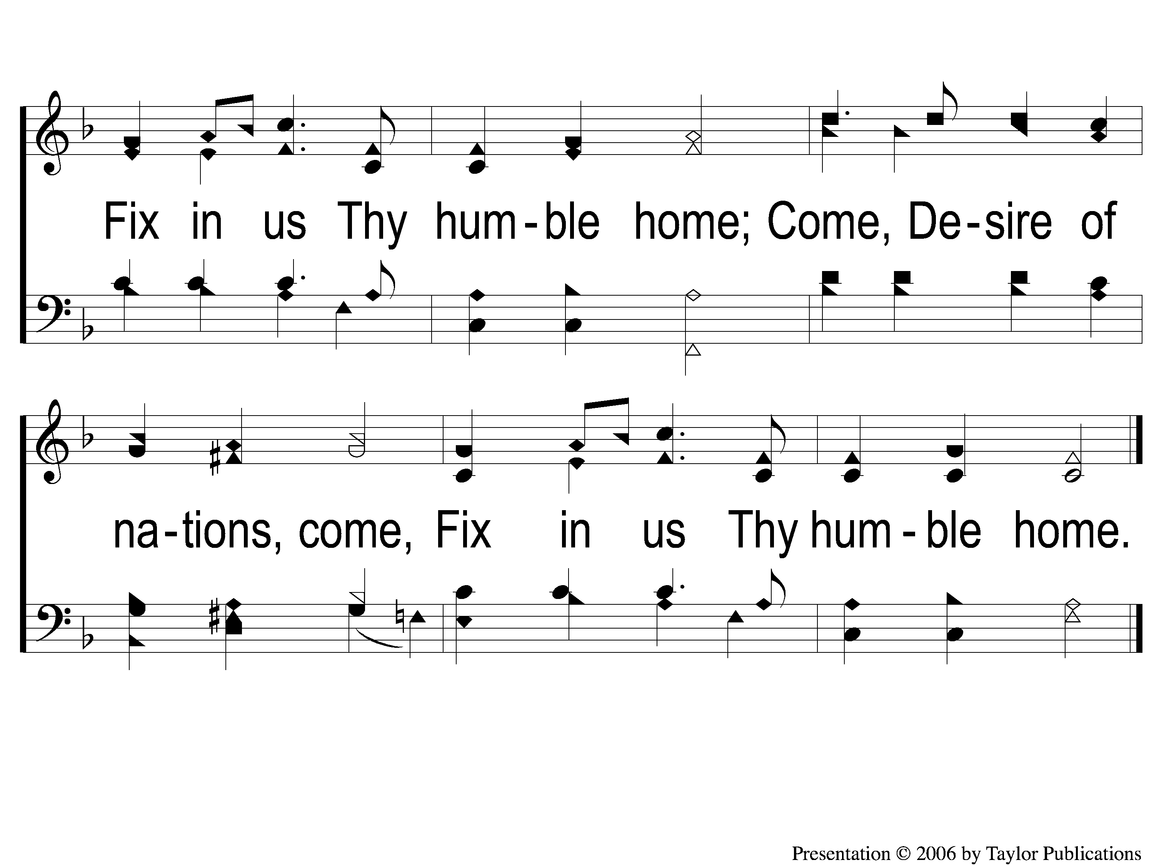
3-4 Hark the Herald Angels Sing
Hark! The Herald Angels Sing
152

